Slide 1

Computerized Cash Advance System
By: Clement Beauvais
Financial Web Application

Slide 2
Project Motivation
I was motivated by a friend name Vernel Mamphil
F&B Release:
based on borrowing money
Notes:
this Idea came to mind three years ago when he had just open a business called F&B released. based on borrowing money and paying the money back with interest. Beta of a Prototype

Slide 3
Project Objective
This software allows a comprehensive computerization of a small Cash Advance business. It will allow the enterprise’s customers the ability to access their information online. Where they will have the
Ability to view outstanding loan amount
Ability to request a new loan amount within credit limit
Ability to make online payments
Ability to view withdrawal and payment history

Slide 4
Project Objective
On the admin side This software allows admins the Ability to
View a list of all credit requests from customers and non customers
Approve or reject credit requests
Activate or deactivate users from the system
Setup users’ payment due dates

Slide 5
Prier knowledge
My prier knowledge before entering this project
Programing in JAVA
A little HTML /CSS
A little Database skill
What truly helped me in getting this project started
Dr. M Carol Hoeke
Anaja Metteluse
Al Delcy
Notes:
When I first started this project the only prier knowledge I had was java which I learn here at usf and I mostly worked with in eclipse JSE(java standard addition ), a little amount of html and CSS and a small amount of data base skills. What truly helped me in getting this project started was my mentor who was very well rounded on data base, a guy by the name Anaja metteluse who directed me to the right site to get help on getting started, and Al Delcy who pointed me to the right direction on the right viewing API to use on this project

Slide 6
Sites
Website called http://courses.caveofprogramming.com/
mkyong
http://www.mkyong.com/spring-security/spring-security-form-login-using-database/
http://www.javacodegeeks.com/2013/04/spring-mvc-hibernate-maven-crud-operations-example.html
http://www.dineshonjava.com/2012/12/spring-3-mvc-tiles-plugin-with-example.html#.VGe5-8mEcw0
Notes:
Some of the sites that was very help full that they sent to me while working on the project was website called http://courses.caveofprogramming.com/ created by Guy name jhon on this site you can find video tutorials and articles to help you learn the art of software development quickly and effectively. Some of his tutorials were free but some of them you would have to log in to his sight and pay fee of about 28$ to help you get started.
Another help full tull that

Slide 7
Technologies used
This web application will be able to run on any web browser. Here are the technologies used:
Eclipse Indigo with JDK 1.6
J2EE
Apache Tomcat web server
MySQL Server 5.6 database
BCRYPT encryption for password encryption
Spring MVC
Hibernate (Object-relational mapping API for data persistence)
Notes:
to get me started I had to Sett up my environment at first I had java Eclipse java stander

Slide 8
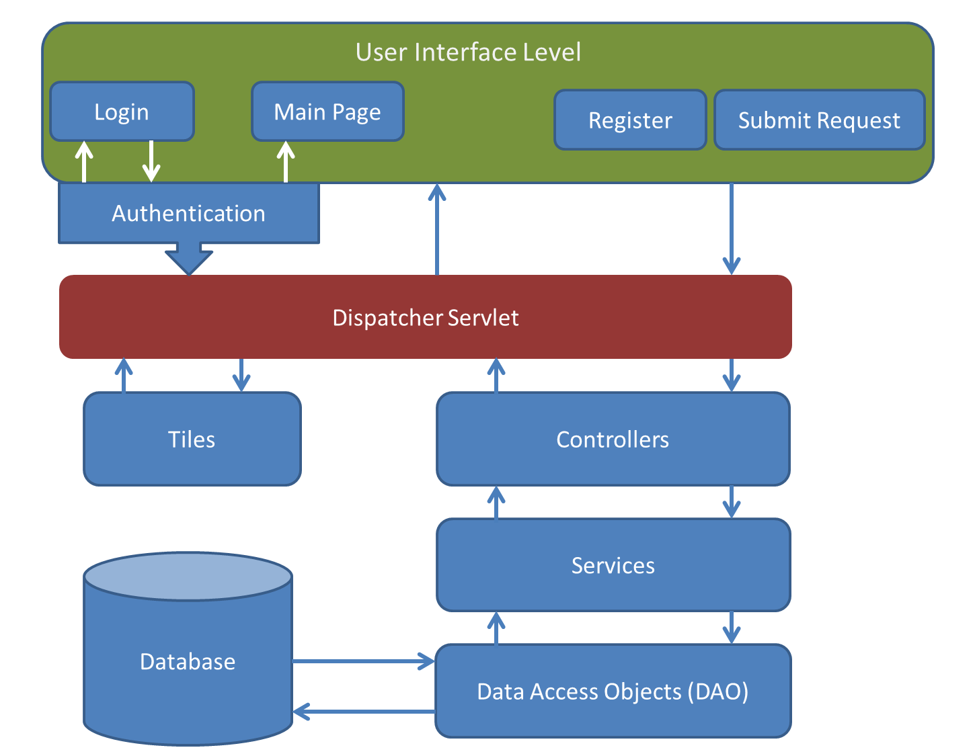
SYSTEM ARCHITECTURE
Notes:
The Computerized Cash Advance application is implemented using the Spring MVC framework. Well how do Spring MVC work
The Presentation or UI level communicates with the backend through a dispatcher servlet. The dispatcher servlet takes in a request (a URL) from the browser and identifies the appropriate controller to route it to. Once passed to the controller, the information is routed to the appropriate service. The service then gets all the data it needs to do its job from the DAO layer. With the help of Hibernate, data from the database is converted into objects which can then be used by the application. Once the request is completed, the controller passes the model and the view (to render model) back to the dispatcher servlet. The Computerized Cash Advance System uses Spring Security to authenticate user access of the application.

Slide 9
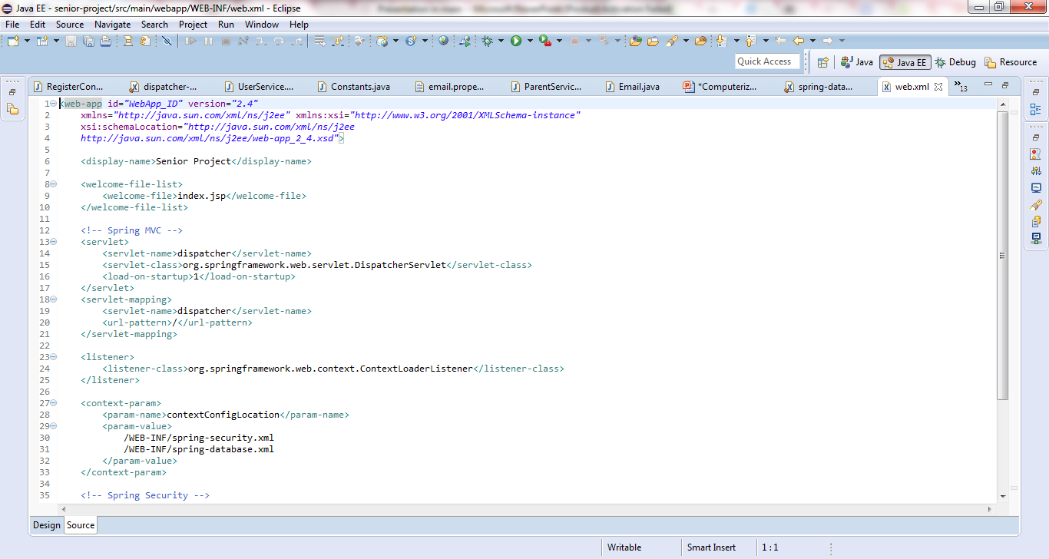
Web xml

Slide 10
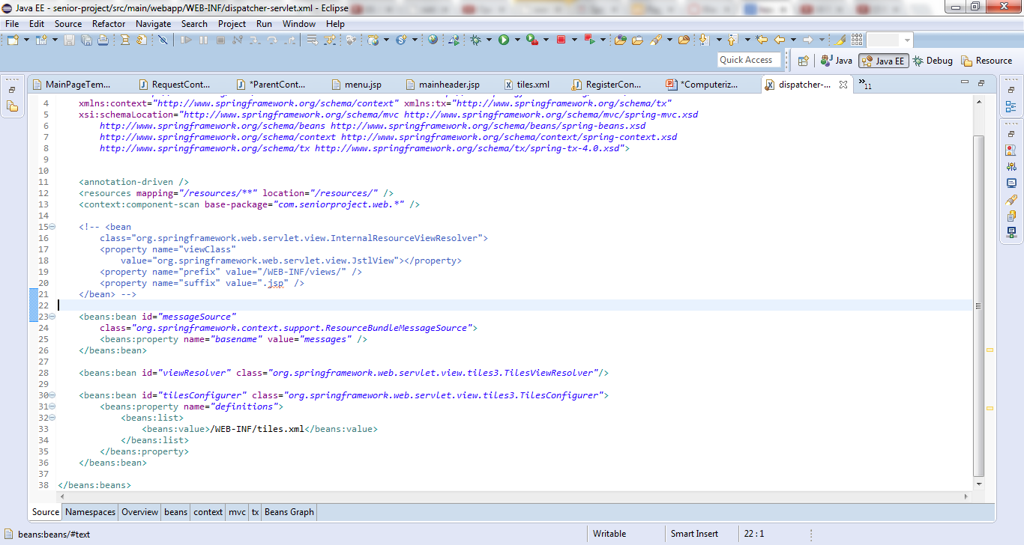
Dispatcher servlet xml

Slide 11
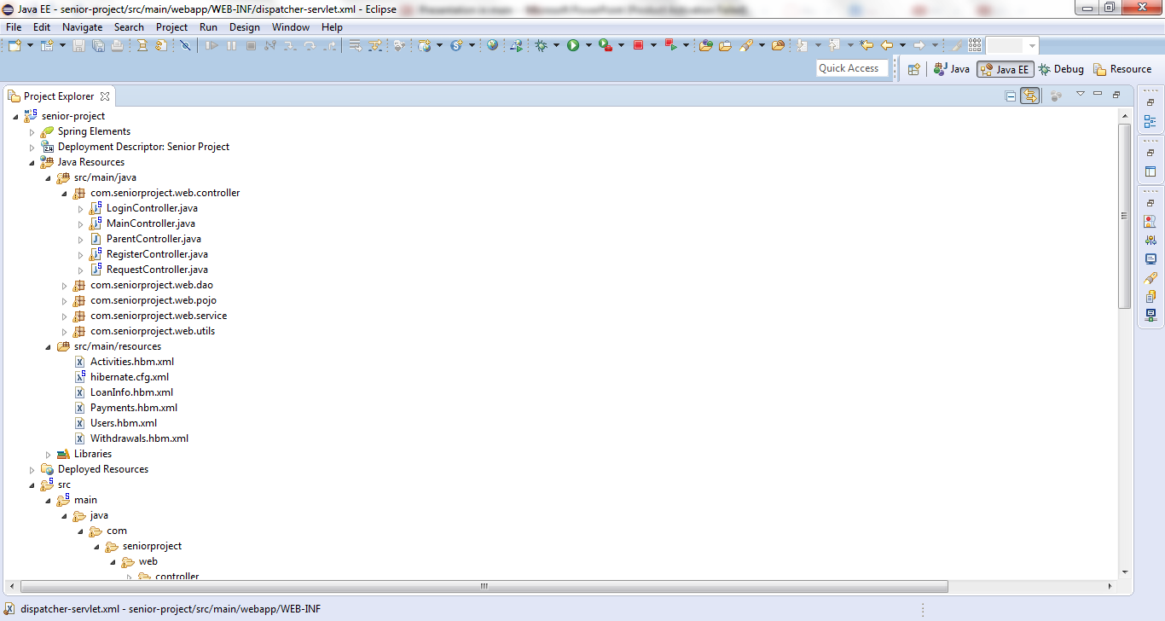
My files

Slide 12
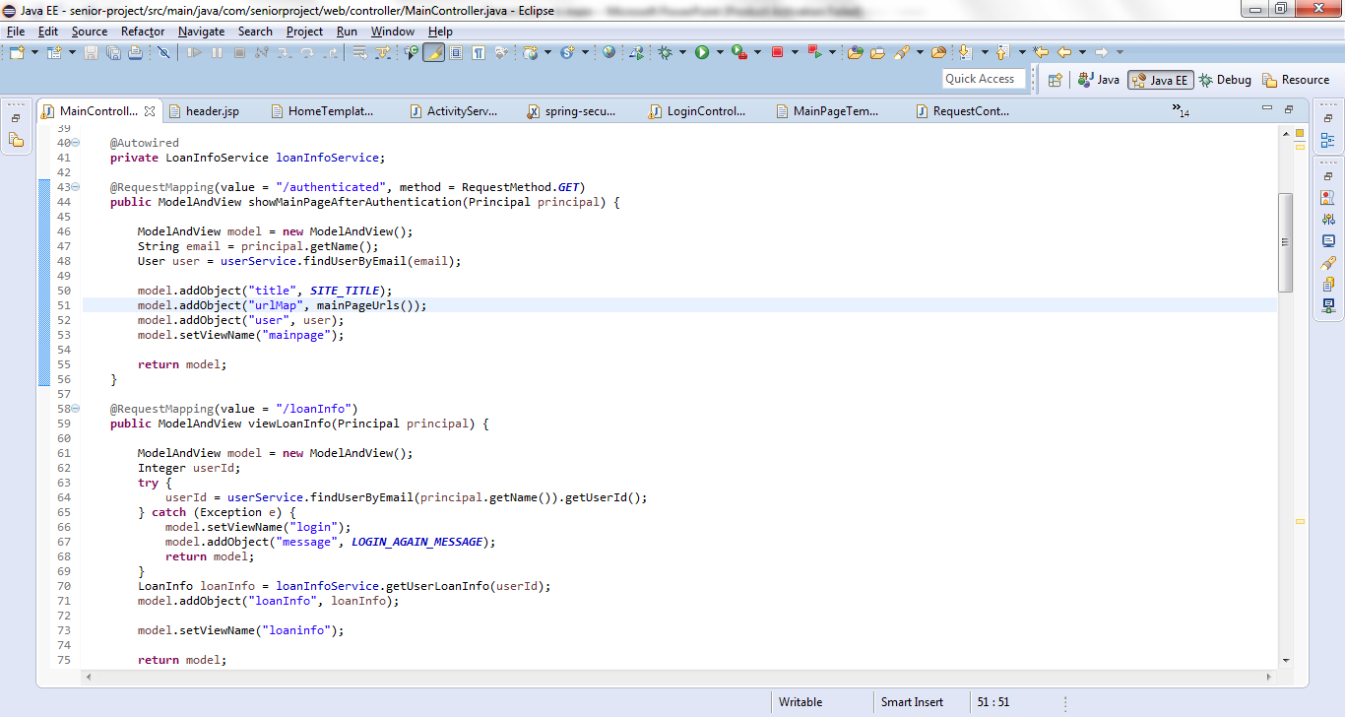
Main Controll

Slide 13
Spring MVC
The Spring MVC framework was chosen for the implementation of this application because it allows a smooth development of J2EE applications.
Spring provided a very clean division between my controllers, models, and views.
It was very flexible
It worked well with the view technology that I selected for the web application: Tile
Because of its popularity, I was able to find a lot more documentation for it when I needed help.

Slide 14
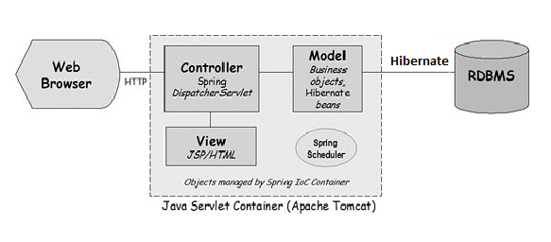
Spring MVC

Slide 15
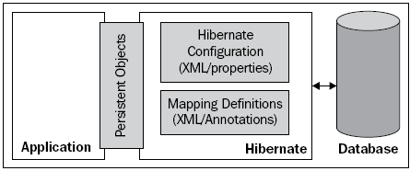
SYSTEM ARCHITECTURE
Notes:
I did not get the chance to show you were hibernate is located with in all of this but . Hibernate which is an Object Relational Mapping tool, stands in-between the data base and J2EE application (Java Enterprise Edition). It helps create this connection by using an XML configuration file to map the POJO to the tables with in the schemas, and different properties to connect with the data base.

Slide 16
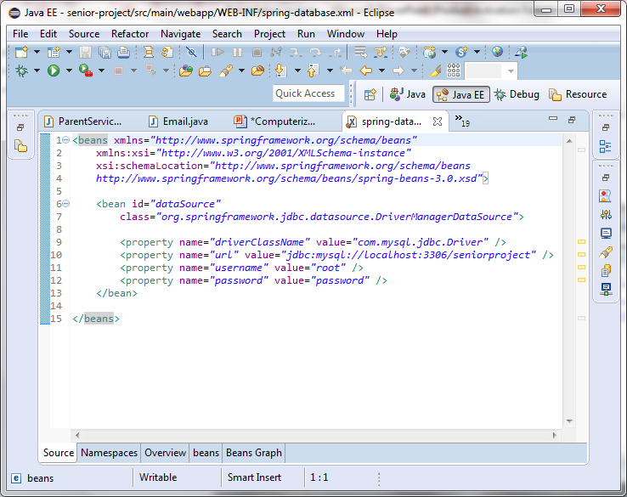
XMl file

Slide 17
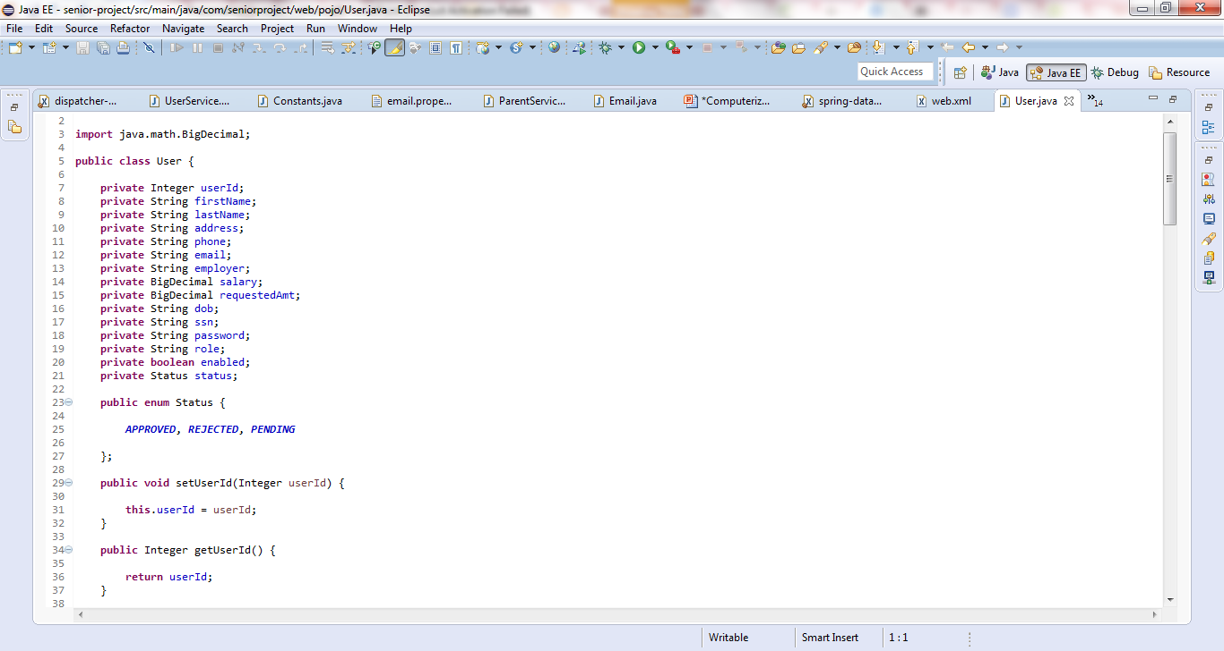
POJO file
Notes:
You have all your pojo files with its gets in seters

Slide 18
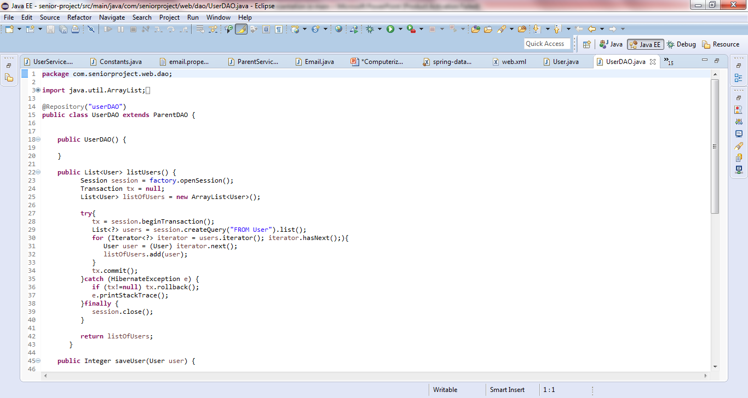
DAO files

Slide 19
Hibernate
One of the reason why I had chosen hibernate is because Hibernate can be used to generate SQL really quickly Hibernate has its own query language and it can automatically executes the necessary SQL statements. Other great advantage Hibernate is that
Hibernate supports relationships like One-To-Many, One-To-One, Many-To-Many-to-Many, Many-To-One
hibernate supporting inheritance
Hibernate has capability to generate primary keys automatically while we are storing the records into database.
Notes:
1. Hibernate supports relationships like One-To-Many,One-To-One, Many-To-Many-to-Many, Many-To-One
2. Hibernate supporting inheritance for example: In hibernate if we save the derived class object, then its base class object will also be stored into the database
3. Hibernate has capability to generate primary keys automatically while we are storing the records into database.
4. Hibernate has its own query language. And it makes it easier to create the query that you need for the project
ORM framework tool

Slide 20
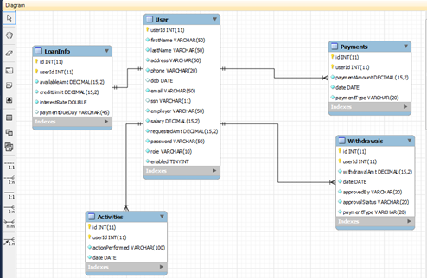
DATABASE ARCHITECTURE

Slide 21
TABLE
ACTIVITIES: The activity table carries four attribute, action performed, date, ID, and User ID. The User ID with in this Activity is what connects the Activity with the User ID tables.
LOAN INFO: lone info have a one on one relationship with user table. It contains the available amount, credit limit, interest rate, and payment due as the attribute. The user table is connected to this table by a LOANID foreign key.
PAYMENTS: In this table we have payment type, the date of the payment and the payment amount, the user table have a relationship with this table through Payment’s ID foreign key
USER: The user is the main table that connect all the tables to its self and it is doing this with the USER ID primary keys
WITHDRAWALS: With the withdrawal table, this table has about 8 attribute one of them that represent the primary key the other is a foreign key that connect user table with the withdrawal.
Notes:
The domain in this diagram is the restriction that is place with in most of the attributes in the data base table. Each attribute is given a data type that is also restricted by numerical numbers and keys. These are some list of data types which has been added to the central MySQL database.

Slide 22
HUMAN INTERFACE DESIGN
Notes:
The relationship between these diagrams above describes the complete functionality of the system. In the diagram above shows four square and two rectangles. The square in the middle represents the data base for the whole application. Its roles and responsibility is to store all of the information that is given to it by the visitor, the admen, or the client. In this diagram the visitor first submit a request; this request is then saved on the database for further review by the admen. Once the admen review the visitor’s information they then send an email back to the visitor giving them permission to register. After the visitor register, the registration is now saved on the data base. Now the visitors can have access to the data base as a User by logging in. In order to access the application a user must go through in authentication process. Once authenticated the user is able to access and modify his/her information

Slide 23
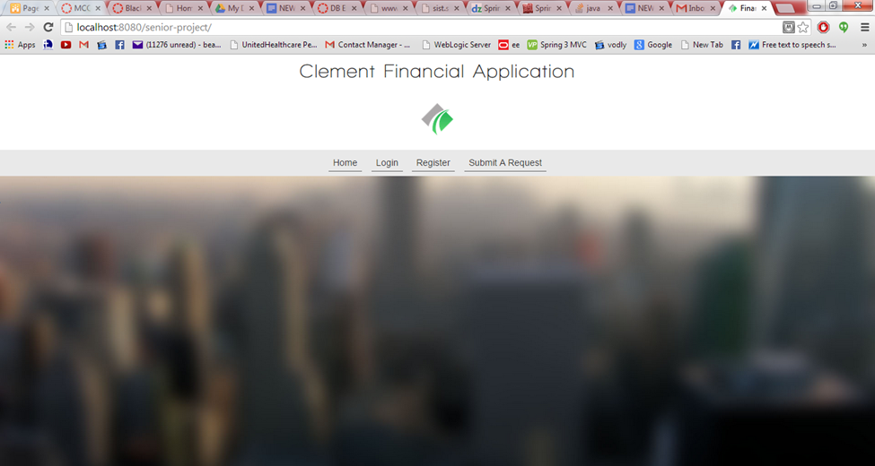
Demonstration

